Slide 1
The Impact of AI Tools on Students' Learning Experience
Assignment 2: Survey Development & Analysis
Presented by: M. Sajid Bashir, Nicolas Bernal, Emma Desbois
Student – TU Wien
105.708 Data Acquisition and Survey Methods (VU 2.0)
23 June 2025
Notes:
today I'll take you on a journey from simple mobile signals to the powerful insights they can unlock.
We'll see how GSM data, when analyzed with the help of machine learning, can support public safety by considering ethical issues and empowers responsible action.

Slide 2

Research Questions
?
Do students who use AI tools complete their academic tasks in less time while maintaining or improving the quality of their work compared to those who do not use AI tools?
RQ1
Does the frequency of AI tool usage increase students’ motivation and engagement during their studies?
RQ2
Do students who include AI tools into their study routines demonstrate better long‑term retention of learned material compared to those who do not?
RQ3
Notes:
"Why is this important?
First, mobile networks generate an ocean of data every single day.
Second, that data is underused, yet it may contain the clues to uncover hidden criminal activity.
And finally, our goal today is to show how GSM data, when paired with ML, can help create safer societies — ethically and intelligently."

Slide 3
Survey Design
1
TU Wien students from programs such as Data Science, Computer Science, and Business Informatics
Target Group
2
Online survey with both quantitative and categorical questions
Data Collection Method
3
98 participants
Total Respondents
4
Demographics (age, gender, program)
AI tool usage and frequency
Opinions on time-saving, quality, motivation, and retention (Likert-style)
Question Types
Notes:
"But it’s not easy.There are four major challenges:
Volume — billions of records daily
Complexity — multiple IDs per user
Disconnection — scattered data sources
False leads — legitimate behavior may look suspicious
We need smart tools to handle this.

Slide 4
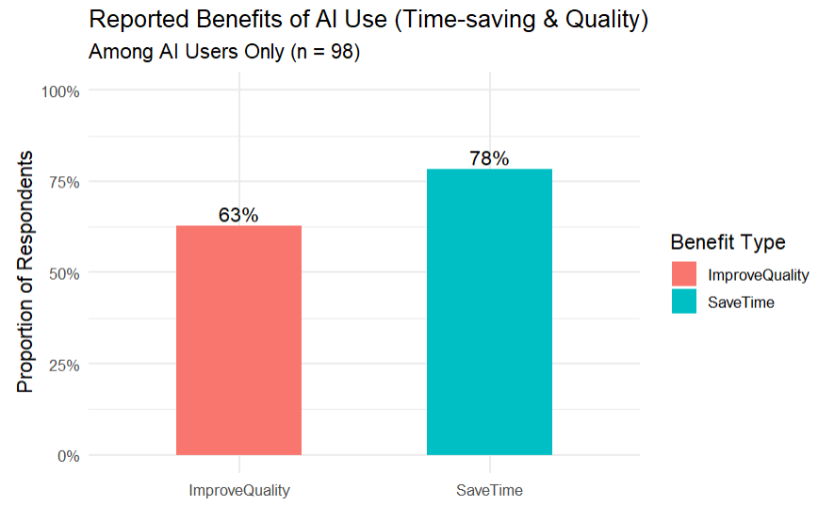
Exploratory Data Analysis – RQ1: Time-Saving & Quality Improvement
Research Question:
Do AI tools help students complete academic tasks faster and with better quality?
Findings:
78% of AI users said AI tools saved them time
63% reported improved quality of academic work
Analysis based on 98 AI-using students
No comparison to non-users was possible due to lack of data
Notes:
To understand the data, we need to know the structure.
GSM networks consist of different components: BTS, BSC, MSC, and more.Each plays a role — BTS connects to your phone, BSC manages towers,
MSC switches calls, and HLR/VLR hold user info.Every step generates valuable metadata."

Slide 5
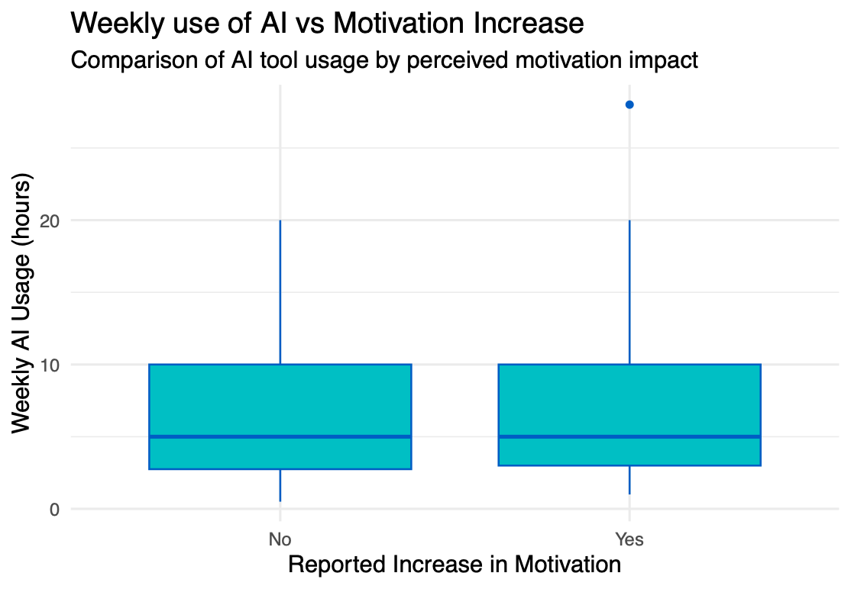
Exploratory Data Analysis – RQ2: Motivation vs. AI Usage Frequency
Research Question:
Does the frequency of AI tool usage increase students’ motivation and engagement?
Findings:
Median, first quartile, and third quartile of weekly AI usage are nearly identical for both groups (5, 4, and 10 hours respectively).
This suggests no significant difference in AI usage between those who reported an increase in motivation and those who did not.
Notes:
To understand the data, we need to know the structure.
GSM networks consist of different components: BTS, BSC, MSC, and more.Each plays a role — BTS connects to your phone, BSC manages towers,
MSC switches calls, and HLR/VLR hold user info.Every step generates valuable metadata."

Slide 6
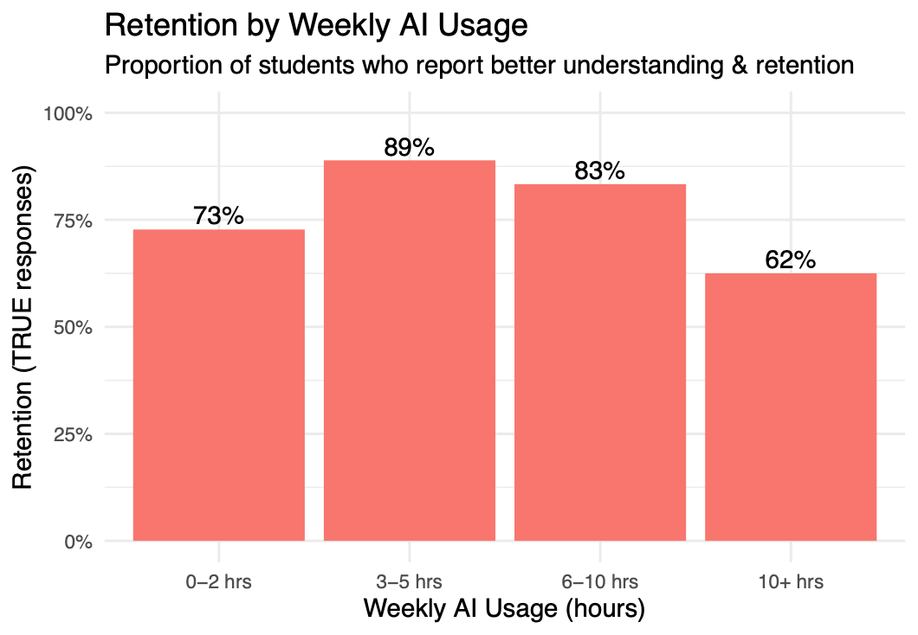
Exploratory Data Analysis – RQ3: Retention vs. AI Usage Frequency
Research Question:
Do students who use AI tools more frequently report better long-term retention of learned material?
Findings:
3–5 hrs/week users reported the highest retention (89%)
6–10 hrs/week also high (83%)
Retention drops for 10+ hrs/week (62%)
Moderate usage appears more effective for retention than excessive usage
Notes:
To understand the data, we need to know the structure.
GSM networks consist of different components: BTS, BSC, MSC, and more.Each plays a role — BTS connects to your phone, BSC manages towers,
MSC switches calls, and HLR/VLR hold user info.Every step generates valuable metadata."

Slide 7
Descriptive Inference – Summary Statistics
Variable | Mean | SD | Min | Max
Age | 25.8 | 4.5 | 4 | 45
AI Hours | 7.0 | 5.7 | 0.5 | 28
Age
Average age was 25.8 years, with a few outliers like age 4 likely due to entry error.
Summary Statistics
Weekly AI Usage
Students used AI tools for an average of 7.0 hours/week, with a few high-usage outliers skewing the data.
Notes:
This is where machine learning comes in.
It helps us cluster user behavior, detect anomalies like SIM swaps, and map hidden communication patterns using graph theory.
It finds what humans can’t — and does so at scale.

Slide 8

Analytic Inference – RQ1: Time-Saving & Quality (Binomial Test)
Research Question
Do AI tools help students complete academic tasks faster and with better quality?
Statistical Test
RQ1
One-sample binomial test (tested against 50% baseline)
Results
Interpretation!
Time-saving: 78% agreed, p < 0.00001 → significant
Quality improvement: 62% agreed,
p = 0.0098 → significant
A statistically significant majority of AI users report both time-saving and quality benefits.
Notes:
"So what kind of data are we talking about?
Call Detail Records (CDRs), IMEI and IMSI numbers, MSISDN (your number), location IDs, port-outs, and timestamps.
This data forms a rich layer of behavioral and spatial information — the raw material for machine learning."

Slide 9

Analytic Inference – RQ2: Motivation & AI Usage (Logistic Regression)
Research Question
Does the number of hours spent using AI tools per week predict students' motivation levels?
Statistical Test
RQ2
Logistic regression
Outcome: Motivation (binary)
Predictor: AI Hours (numeric)
Results
Interpretation!
Coefficient for ai_hours: 0.005
p-value: 0.867
Interpretation: Not statistically significant
No significant relationship found between AI usage hours and reported motivation.
Notes:
"So what kind of data are we talking about?
Call Detail Records (CDRs), IMEI and IMSI numbers, MSISDN (your number), location IDs, port-outs, and timestamps.
This data forms a rich layer of behavioral and spatial information — the raw material for machine learning."

Slide 10
Analytic Inference – RQ3: Retention & AI Usage (Logistic Regression)
Research Question
Does weekly AI usage predict whether students report better understanding and long-term retention?
Statistical Test
RQ3
Logistic regression
Outcome: Retention (binary)
Predictor: AI Hours (numeric)
Results
Interpretation!
Coefficient for ai_hours: -0.041
p-value: 0.31
Interpretation:
Not statistically significant
No significant relationship found between weekly AI usage and reported retention.”
Notes:
"So what kind of data are we talking about?
Call Detail Records (CDRs), IMEI and IMSI numbers, MSISDN (your number), location IDs, port-outs, and timestamps.
This data forms a rich layer of behavioral and spatial information — the raw material for machine learning."

Slide 11

Discussion & Conclusion
“AI tools are widely used and perceived as beneficial, especially for task efficiency and quality. However, their effect on motivation and learning retention is less clear.”
RQ1: Significant majority of students reported time-saving (78%) and improved quality (62%) using AI tools
RQ2: No significant link between weekly AI use and reported motivation
RQ3: No significant link between weekly AI use and perceived retention
Notes:
"In every signal, there is a pattern.
Our job is to read it — not misuse it.
GSM and ML can be tools for peace, justice, and safety — but only if we use them responsibly.
Thank you."

